Slide 1
IST 722 EVENT MANAGEMENT
GROUP A
NAKUL RATTAN
IMMANUEL NII ODAI ODARTEIFIO

Slide 2
TEAM
NAKUL – Lead Dev (Snowflake)
NII – Lead Dev (dbt)

Slide 3
goals
Identify business processes
01
Create the Bus Matrix and Dimensional Models
02
Create pipeline to Snowflake
03
Build the Data Warehouse
04

Slide 4
OVERVIEW OF BUSINESS PROCESSES
Event Ticket Sales
Periodic Snapshot of number of tickets sold per event
Each row represents an event
Request Approvals
Accumulating Snapshot of the number of approvals per venue
Each row represents a venue
Most Popular Cities
Transaction summary of the most popular cities by average review
One row per city

Slide 5
BUS MATRIX
Business Process Name | Fact Table | Fact Grain Type | Granulairty | Facts | dim_customer | dim_event | dim_request | dim_date | dim_venue | dim_ticket | dim_rating
Event Ticket Sales | fact_event_ticket_sales | Periodic Snapshot | one row per event per day | numofticketssold | x | x |  | x |  | x
Request Approvals | fact_request_approvals | Accumulating Snapshot | one row per venue | numofapprovedrequests |  | x | x |  | x
Most Popular Cities | fact_popular_cities | Transaction | one row per city | avgrating |  | x |  |  | x | x | x

Slide 6
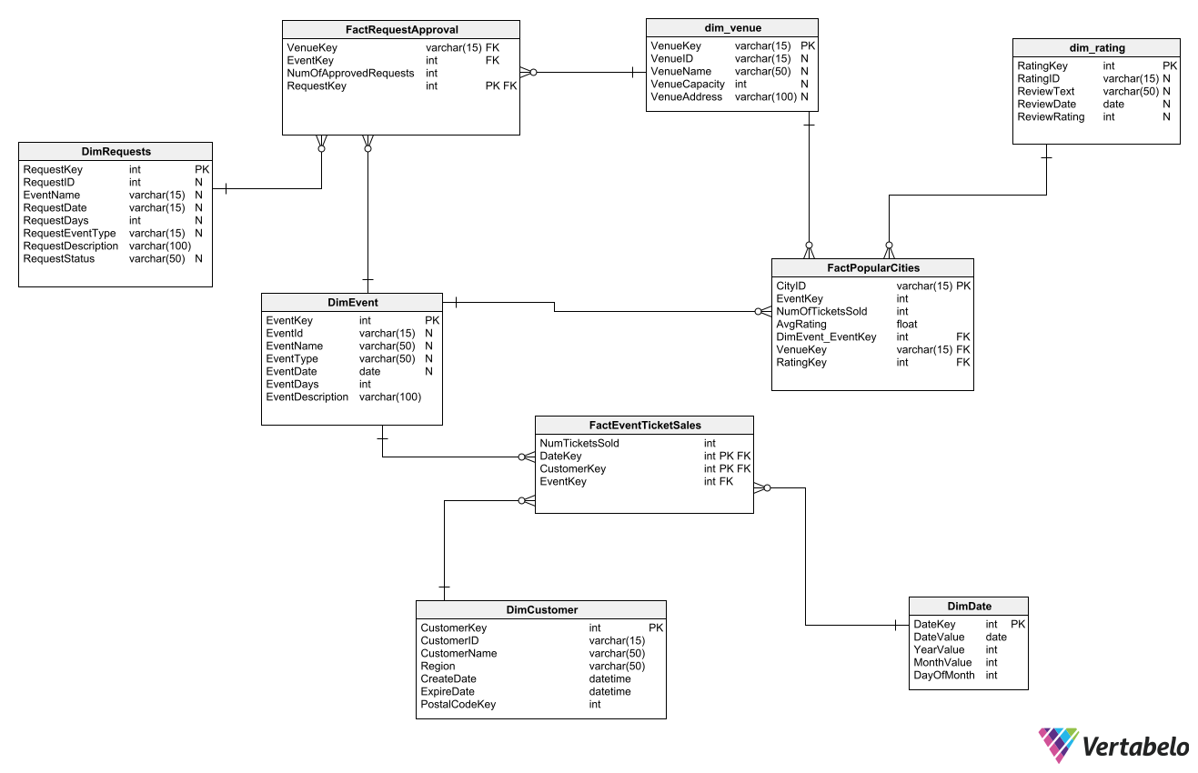
DIMENSIONAL MODEL

Slide 7
Raw data
TABLE_CATALOG | TABLE_SCHEMA | TABLE_NAME | ROW_COUNT
RAW | MYEVENT_V1 | EVENTS | 5
RAW | MYEVENT_V1 | EVENT_TYPES | 5
RAW | MYEVENT_V1 | ORGANIZATIONS | 12
RAW | MYEVENT_V1 | ORGANIZATION_TYPE_LOOKUP | 4
RAW | MYEVENT_V1 | PEOPLE | 20
RAW | MYEVENT_V1 | REQUESTS | 8
RAW | MYEVENT_V1 | REQUEST_STATUSES | 3
RAW | MYEVENT_V1 | REVIEWS | 2
RAW | MYEVENT_V1 | SERVICES | 6
RAW | MYEVENT_V1 | SERVICE_TYPE | 1
RAW | MYEVENT_V1 | TICKETS | 15
RAW | MYEVENT_V1 | TYPE_OF_SERVICES | 5
RAW | MYEVENT_V1 | VENUES | 7
RAW | MYEVENT_V1 | V_OWNER_EVENTS
RAW | MYEVENT_V1 | V_VIEW_OWNERS
RAW | MYEVENT_V1 | V_VIEW_REQUESTS
RAW | MYEVENT_V1 | V_VIEW_REVIEWS
RAW | MYEVENT_V1 | V_VIEW_TICKET
RAW | MYEVENT_V1 | ZIPCODES | 13

Slide 8
Dimensions and fact tables
TABLE_CATALOG | TABLE_SCHEMA | TABLE_NAME | ROW_COUNT
ANALYTICS | DBT_NRATTAN_MYEVENT_V1 | DIM_CUSTOMER | 20
ANALYTICS | DBT_NRATTAN_MYEVENT_V1 | DIM_DATE | 10950
ANALYTICS | DBT_NRATTAN_MYEVENT_V1 | DIM_EVENT | 5
ANALYTICS | DBT_NRATTAN_MYEVENT_V1 | DIM_REQUEST | 8
ANALYTICS | DBT_NRATTAN_MYEVENT_V1 | DIM_REVIEW | 2
ANALYTICS | DBT_NRATTAN_MYEVENT_V1 | DIM_VENUE | 7
ANALYTICS | DBT_NRATTAN_MYEVENT_V1 | FACT_EVENT_TICKET_SALES | 5
ANALYTICS | DBT_NRATTAN_MYEVENT_V1 | FACT_POPULAR_CITIES | 1
ANALYTICS | DBT_NRATTAN_MYEVENT_V1 | FACT_REQUEST_APPROVAL | 4

Slide 9
SUMMARY
Identified business processes
Created the Bus Matrix and Dimensional Models
Created ELT pipeline
Built the Data Warehouse

Slide 10
WHAT WE COULD HAVE DONE WITH MORE TIME
Identified more business processes
BI using the data

Slide 11
Recorded demo of data warehouse
https://video.syr.edu/media/t/1_6eogj5tc

Slide 12
THANK YOU

